Slide 1
Lecture No. 9 Corrosion and its control
At the end of this lecture, students will be able to:
Describe the process of Corrosion
Identify the types of corrosion
Explain Galvanic series

Slide 2
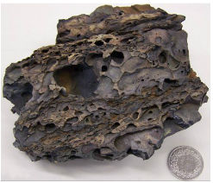
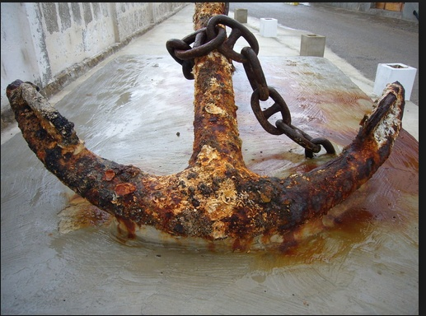
Corrosion Science
Destruction and consequent loss of metal due to its reaction with surrounding
Decay process in which meal exhibit their natural tendency to go back to their original state of existence as minerals (ex : oxides, sulphides, corbonates)
Nobel metals such as gold and platinum exist in nature as metals and are not susceptible to corrosion under ordinary atmospheric conditions
Sliver does not rust, but tarnished
It reacts with H2S found in food or water to from silver sulfide

Slide 3
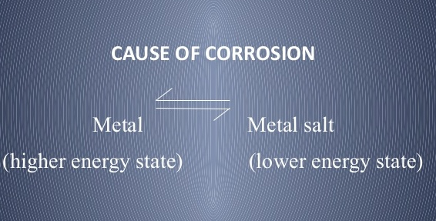
Corrosion Science
Metals have free energies greater than their compounds
Tend to become their compounds through the process of corrosion

Slide 4
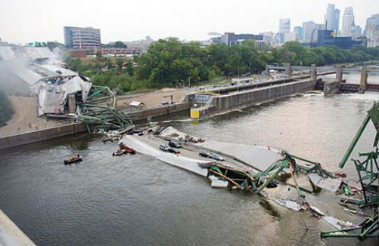
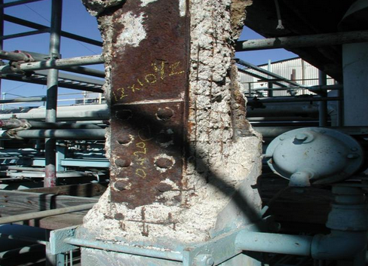
Corrosion Science
Destruction of metals or alloys by the surrounding environment through chemical or electrochemical changes is known as corrosion
Corrosion is a natural process
Represents a return of metals to their more natural state as minerals (oxides)

Slide 5
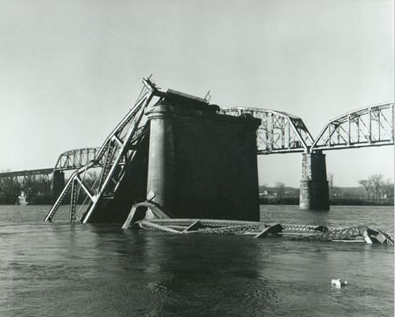
Why we have to study corrosion?
Process products in chemical industry get contaminated with the corrosion product, the contaminated product becomes no more useful resulting in loss of products
Collapse of building /bridge/other structures
Instrument get deteriorated
Annual loss due to corrosion is estimated to be 4 to 5% of the Gross National Product (GNP)
Injuries to people arising from structural failure or breakdown
Notes:
Gross national product (GNP) is the market value of all the products and services produced in one year by labour and property supplied by the citizens of a country.

Slide 6
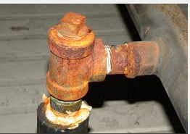
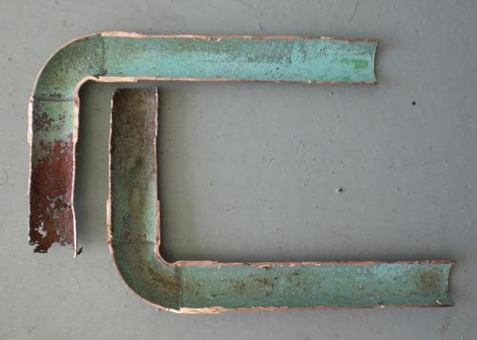
Types of corrosion
Dry corrosion or chemical corrosion
Wet corrosion or electrochemical corrosion
Dry Corrosion: Involves the direct attack of metals by dry gases mainly through chemical reactions
Ex: i) Cl₂, SO₂ fumes comes in contact with any steel container
ii) The attack of dry air on a metal to form oxide
iii) CO₂ attacking copper to form copper carbonate, a green scale

Slide 7
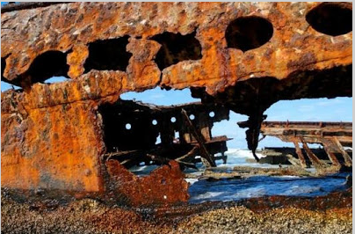
Wet Corrosion
Involves reactions in aqueous medium
Conducting surface of the metal undergoes an electrochemical
reaction with moisture and oxygen present in the atmosphere
Ex: Rusting of iron

Slide 8
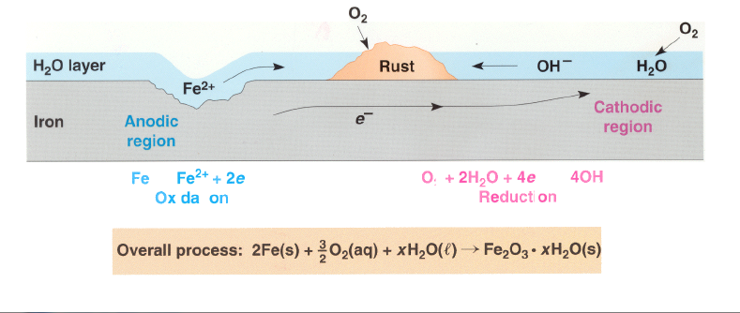
Electrochemical Theory of Corrosion
When a metal surface is exposed to the atmospheric air the following electrochemical changes occur gradually
Formation of galvanic cells: Anodic and Cathodic areas are formed resulting in formation of minute galvanic cells
Anodic reaction: oxidation or corrosion takes place
M → M^{n+} + ne⁻
Ex: Fe → Fe²⁺ + 2e⁻
Cathodic reaction: The electron flows from anodic to cathodic areas and causes reduction

Slide 9



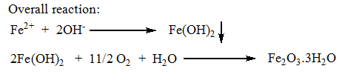
Reactions at cathodic region: At cathode, depending on the surrounding medium the reaction is either a) liberation of hydrogen or b) absorption of oxygen
a) Liberation of hydrogen ( in the absence of oxygen)
In acidic medium the reaction is
In neutral or alkaline medium, the reaction is
b) Absorption of oxygen ( in the presence of oxygen)
In acidic medium, the reaction is
In neutral or alkaline medium, the reaction is

Slide 10
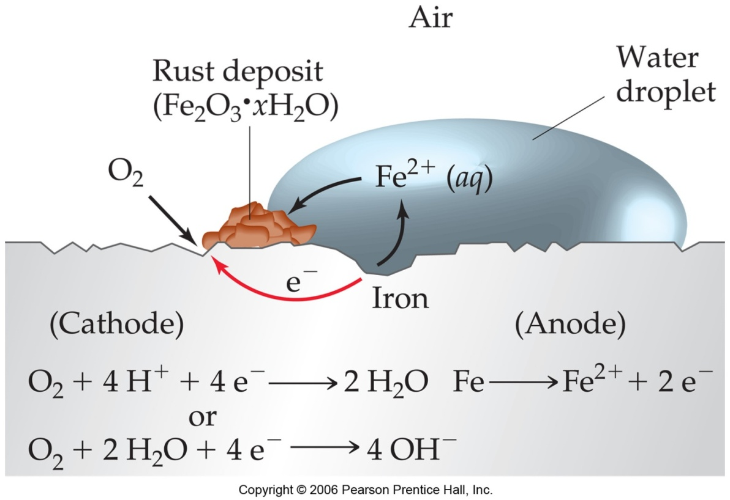
Electrochemical Theory Of Corrosion
Electrochemical Theory of Corrosion
Metal ions formed combine with OH⁻ ions to from the metal hydroxide and finally the hydrated metal oxide (Rust)
Over all reaction: 2Fe²⁺ + 4OH⁻ → 2 Fe (OH) ₂
2Fe (OH) ₂ + O₂ + (n-2) H₂O → Fe₂O₃.nH₂O

Slide 11
Galvanic series
Necessity for the Galvanic series
Electrochemical series is based on standard reduction potential for pure metals, doesn’t give a correct basis for predicting, in a particular environment, whether a metal will corrode or not
Passivity of the metals is not considered
Galvanic series is a more accurate representation of actual galvanic corrosion characteristics than the electrochemical series
Corrosion of alloys is also accounted
Galvanic series is built on corrosion studies of metals and alloys in sea water (determines the nobility of metals and semi-metals)

Slide 12
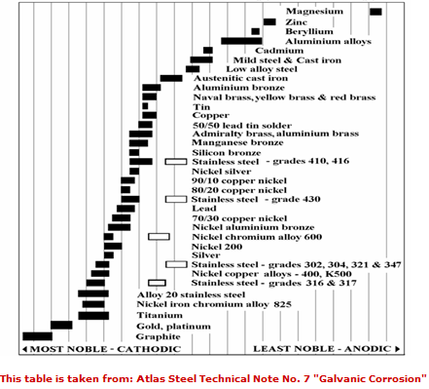
Galvanic Corrosion

Slide 13
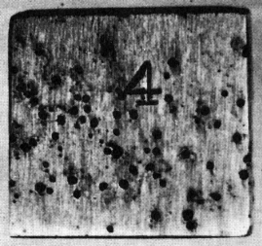
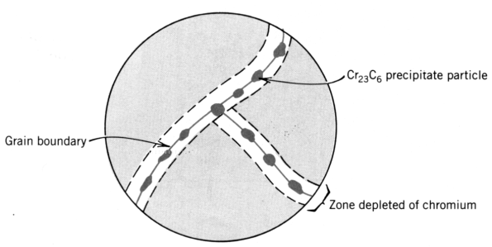
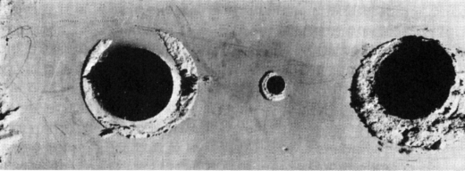
Forms of Corrosion
• Stress corrosion
Stress & corrosion
work together
at crack tips.
• Uniform Attack
Oxidation & reduction
occur uniformly over
surface.
• Erosion-corrosion
Break down of passivating
layer by erosion (pipe
elbows).
• Selective Leaching
Preferred corrosion of
one element/constituent
(e.g., Zn from brass (Cu-Zn)).
• Pitting
Downward propagation
of small pits & holes.
Forms
of
corrosion
• Intergranular
Corrosion along
grain boundaries,
often where special
phases exist.
• Galvanic
Dissimilar metals are
physically joined. The
more anodic one
corrodes.(see Table
above) Zn & Mg
very anodic.
• Crevice Between two
pieces of the same metal.
g.b.
Rivet holes
prec.
attacked
zones

Slide 14
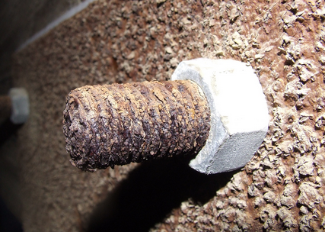
Galvanic Corrosion (Types of Corrosion)
Differential metal corrosion
Differential aeration corrosion
Stress corrosion
Differential metal corrosion (Galvanic corrosion)
For galvanic corrosion to occur, three conditions must be present:
Electrochemically dissimilar metals must be present
Metals must be in electrical contact
Metals must be exposed to an electrolyte

Slide 15
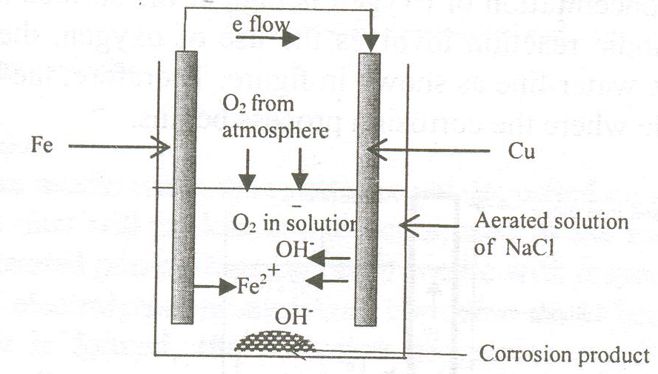
Differential Metal Corrosion
Consider a galvanic cell where in iron and copper are in contact with aerated sodium chloride solution
Reactions taking place in the cell are:
At the anode: Fe → Fe²⁺ + 2e
At the cathode: O₂ + 2H₂O + 2e → 4 OH⁻
2Fe²⁺ + 4OH⁻ → 2 Fe (OH) ₂
2Fe (OH) ₂ + O₂ + (n-2) H₂O → Fe₂O₃.nH₂O

Slide 16
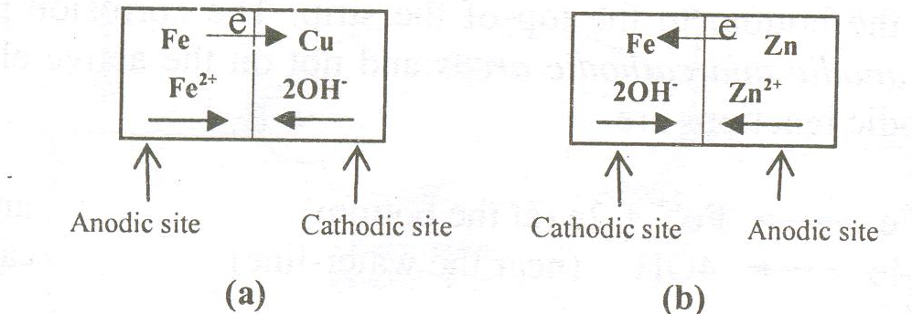
Differential Metal Corrosion
Criteria for anode and cathode
Metal which is above in the galvanic series act as anode and other metal which is below act as cathode
More the reduction potential difference, more will be the rate of corrosion
Iron (-0.44V) acts as anode to Sn (-0.14V), Cu (0.34V), Ni (-0.23V) hence iron undergoes corrosion
Iron (-0.44V) acts as cathode to Mg (-2.37V) and Zn (-0.76V) as result Mg and Zn undergoes corrosion

Slide 17
Differential Metal Corrosion
It occurs when two dissimilar metals are in contact with each other in a corrosive conducting medium
Metal with lower reduction potential acts as anode and gets oxidized and suffers from corrosion
Metal with higher electrode potential acts as cathode and gets reduced
Rate of galvanic corrosion depends upon how far the anode and cathode are placed in the galvanic series
Larger the difference in the electrode potential, more will be the rate of corrosion

Slide 18
Summary
Corrosion is defined as destruction and consequent loss of metal due to its reaction with surrounding
When a metal surface is exposed to the atmospheric air results in electrochemical changes with formation of galvanic cell
Types of corrosion
Wet and dry corrosion

